Slide 1

BYU Silver Fund Review
2020/2021

Slide 2
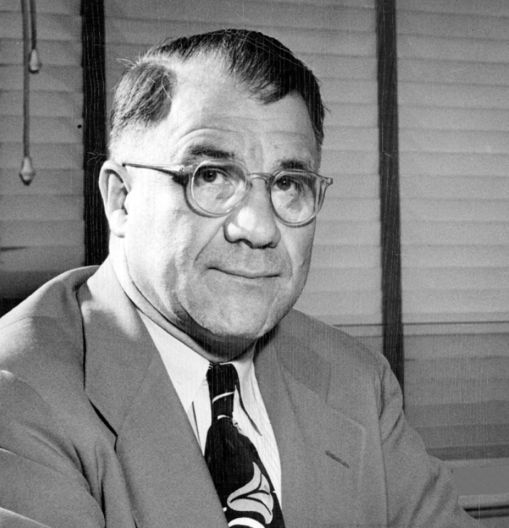
About Silver Fund
Harold F. Silver
Objective: Prepare students for careers in public markets asset management
Develop a sharp, analytical mindset and rigorous investment toolkit
Have opportunities to apply core principles taught elsewhere in the finance curriculum
Succeed in the recruiting process
Philosophy: This a student-run fund.
Seeking alpha through fundamental and quantitative analysis
Faculty advisors serve as their title suggests. Students make the decisions

Slide 3

Class Structure
Fundamentally: run like a real buy-side shop
Teams of Equity analysts
5 Teams: covering 2 sectors each
1 Quant Team
Investment Pitches
Open debate testing assumption and conclusion
Vote on appropriate portfolio actions
Workshops & Guest Speakers

Slide 4
Successes Failures
Team-oriented approach to sector coverage
Industry knowledge created through development of primers
Creation of investment thesis with clear signposts backed by fundamental analysis
Quant team
Stock pitch competition participation (6 teams of 4)
Inefficiency of group decision-making (Zoom friction, limited time for discussion)
Trouble getting trades completed quickly

Slide 5
Silver Fund Portfolio Objectives
2020 - 2021
Notes:
Ellie

Slide 6
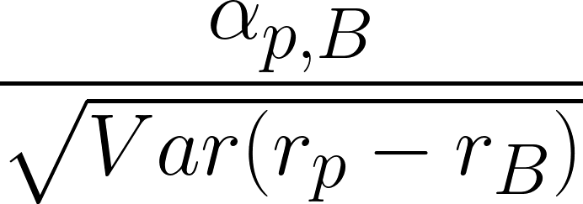
Objective: Maximize the Information Ratio
Information Ratio: IR =
Measures ability to outperform a benchmark
Ratio of active portfolio alpha to tracking error risk
Inputs:
Alpha: expected returns, betas to benchmark, expected return on benchmark
Tracking Error Risk: unexplained returns
Our benchmark: Russell 3000
Process similar to Sharpe ratio maximization:
Maximize active portfolio alpha for a given active risk target, or minimize the active portfolio risk for a given active portfolio alpha target.
Additionally, constrain beta of active portfolio to the benchmark to 0
Notes:
Ellie
Tracking error keeps us close to the benchmark
There are a couple of problems - for me to improve your sharpe ratio, I would need to create positive alpha relative to the portfolio that you hold
Generating positive alpha relative portfolio clients requires knowledge of their holdings
Have to know what my client holds
Generating alpha relative to the clients portfolio requires me to have a different strategy to every portfolio.
It is enough to say that we maximize the information to the benchmark
For a portfolio with a beta of 1, it is the the same as maximizing alpha relative to whatever portfolio.
Alpha benchmark is 0
Beta of my active portfolio is 1

Slide 7
Mean-Variance Optimization for IR Maximization
IR maximization problem has an equivalent mean-variance optimization representation.
What do we need for mean-variance optimization?
Mean (alpha): comes from Silver Fund analysts
Variance: comes from the Silver Fund risk model
Forecast uncertainty adjustment gives less weight to positions for which we are less certain about the true value for alpha.
Uncertainty measured from dispersion of the class-generated expected return distribution.
Notes:
Mark
Mean variance optimization. Give an intuitive explanation for this. “We want to find the portfolio that best trades off risk against return potential.”

Slide 8
Factor Risk Model Motivation
Path to forecast stock covariance matrix
Daily cross-sectional regression
Inputs:
Stock returns
Observed characteristics (loadings)
Estimate factor returns
Notes:
industry, market, size, value, momentum, etc

Slide 9
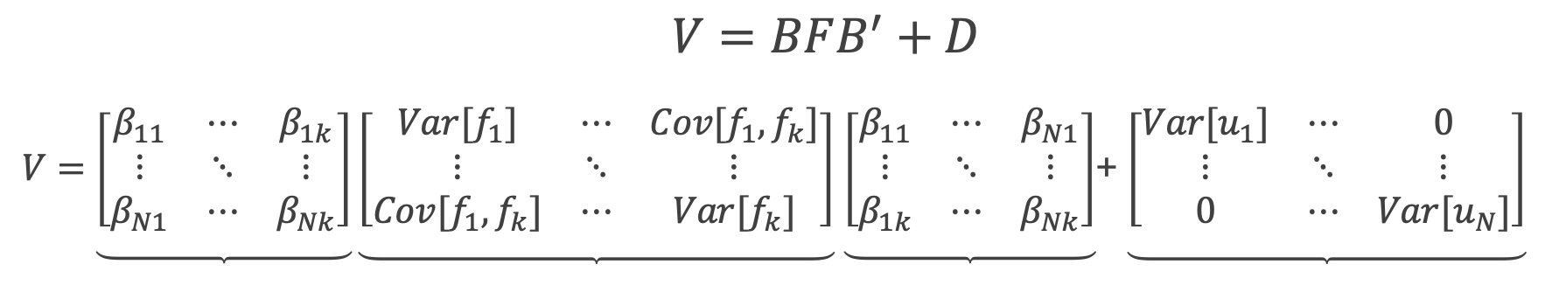
Factor Covariance Matrix
Combine factor returns into factor covariance matrix
Predict next day’s factor covariance matrix
Via EWMA
Factor covariance matrix -> stock covariance matrix
Notes:
Reduce Dimensionality
From 3000x3000 to 60x60

Slide 10
Constrained Optimization
Choose active weights to maximize Information Ratio (IR)
With the constraints:
Portfolio beta to the ETF = 1
Sum of active weights = 0
Scale holdings to achieve active risk target of 4%
Notes:
We never go over our risk target - keeps shorts in

Slide 11
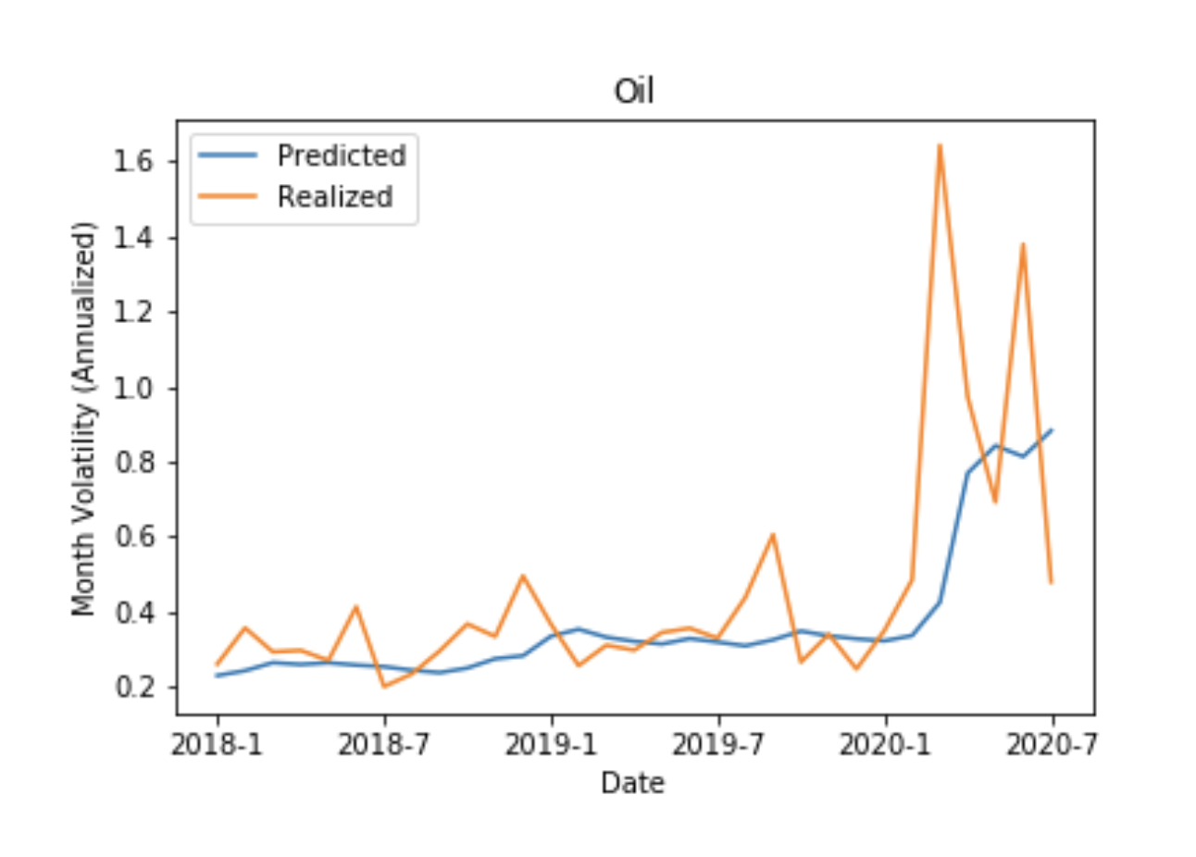
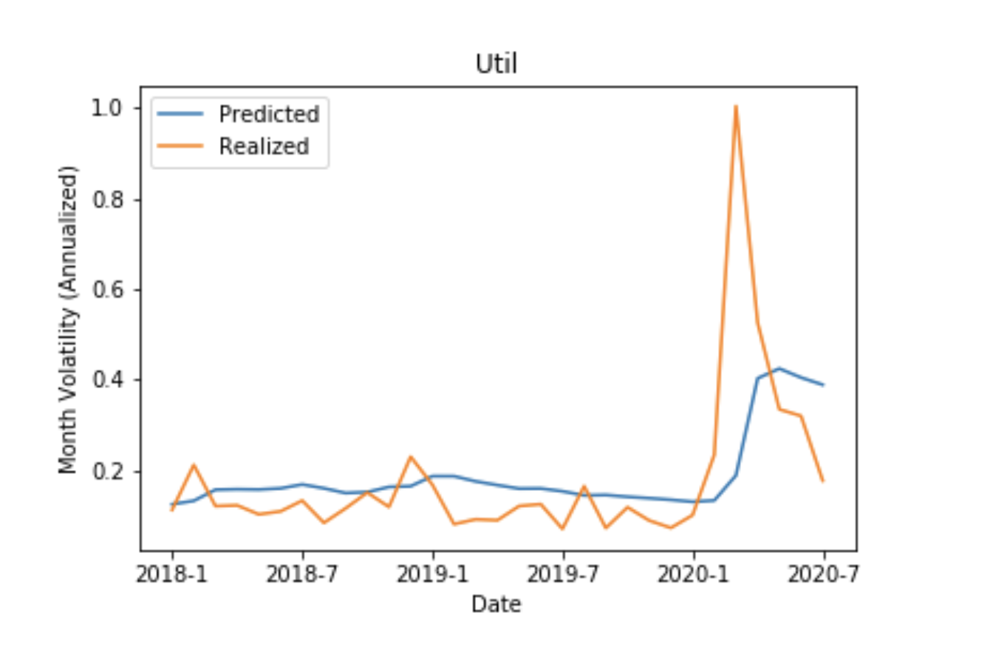
Dynamic Predictions
Notes:
Realized - 2019-7 using all data prior to 2019
Realized taking volatility of July 2019 and then annualizing it

Slide 12
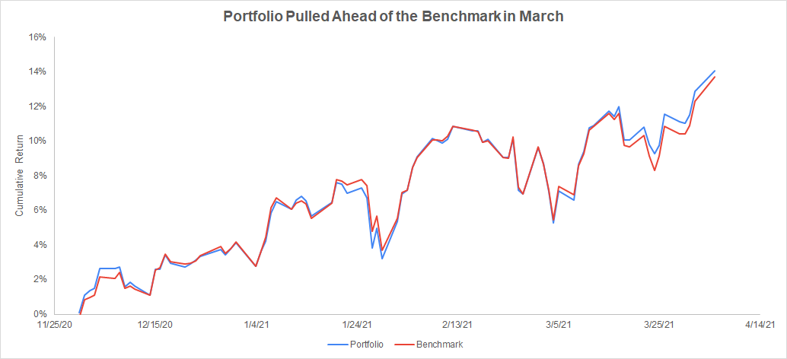
Portfolio Review

Slide 13
Portfolio Positions
+14.1%
Portfolio Return
11/25/2020 - 4/5/2021
+13.7%
Benchmark Return
11/25/2020 - 4/5/2021
+0.18%
Realized Alpha
+0.52%
Annualized Alpha
1.01
Portfolio Beta
+0.24
Information Ratio
1.26%
Realized Tracking Error
2.15%
Annualized Tracking Error
Top Performers
ETSY
WWE
COG
GME
VZ
Contribution to Portfolio Alpha
+0.47%
+0.47%
+0.11%
+0.08%
+0.06%
Underperformers
SFIX
WMT
PFE
Contribution to Portfolio Alpha
-0.41%
-0.11%
-0.05%

Slide 14
Real Estate & Financial Sector Review
2020/2021

Slide 15
Ticker | MPW | PGR
Date Purchased | 11/25/2020 | 03/23/2021
Price Purchased | $19.6983 | $90.6183
Target Price | $22.00 | $115.86
Horizon | 6 months | 1 year
Initial Weight | 2% | 2%
Current Price | $21.66 | $97.29
Return Over Holding Period | 12.7% | 6.4%
IVW Return Over Holding Period | 15% | 5.4%
Beta | 0.81 | 0.036
Realized Alpha | 0.96% | 6.52%
Contribution to Portfolio Alpha | 0.0192% | 0.13%

Slide 16
Investment Review, MPW
Based on our research, we believe the market is overestimating the impact that COVID-19 will have on the long-term health of MPW’s business.
While COVID-19 has caused a decrease in revenue for many hospital operators MPW is better poised than their competitors.
MPW acquired several new healthcare properties during the first 3 quarters of 2020 which has positioned it well to accelerate it FFO in the coming quarters.

Slide 17
Overestimation of COVID-19 Impact
Revenue Growth
Due to the nature of the COVID-19 pandemic, many hospital operators had to stop their elective surgeries.
The market expected revenues to decrease for healthcare REITs, but MPW was better poised than its competitors against these revenue decreases.
MPW: 46%; due to acquisitions
OHI: -12.5%; due to operator risk
PEAK: -17.6%; due to inability to re-lease properties
MPW collected 98% of rents in 2020, remaining 2% have rental deferment plans
Property holdings
Hospitals versus Medical Office (0%,1%, 42%), Senior Housing (5%, 97%,13%)
Location and state restrictions
Notes:
Nationally: 221 properties in 33 states
Globally: 49% of portfolio is outside United States (UK, Germany, Spain, Australia)

Slide 18
Acquisitions
Acquisitions
Invested $3.6 billion in medical real estate, including 40+ acquisitions in 2020
Total asset growth of 16% YoY
Continued diversification; new property types, entered 9 new countries in 2020
Closed a deal in Jan 2021 to acquire 40 behavioral health centers for approx. $1B
Maintain $550M in cash and other liquid assets
FFO Growth
FFO improved 21% YoY in 2020
FFO/share increased 20.7% YoY to $1.57/share
FFO growth primarily due to increased revenue via acquisitions

Slide 19
Lessons Learned
Selecting the right valuation multiple
VNO
EV/EBITDA implied the company was extremely overvalued (52.7x vs. 25.3x avg.)
Does not account for investment property appreciation
FFO Multiples implied that the company was at or below industry average
Does not include non-recurring gains and losses
EV/EBITDA
Best when comparing companies with a similar level of capital intensity (depreciation as a % of EBITDA)
Analyze industry-specific financial ratios & metrics
Insurance - Loss Ratio & Combined Ratio
REITs - FFO/AFFO, Payout Ratio

Slide 20


Team 3 - Consumer Stables &
Information Technology

Slide 21
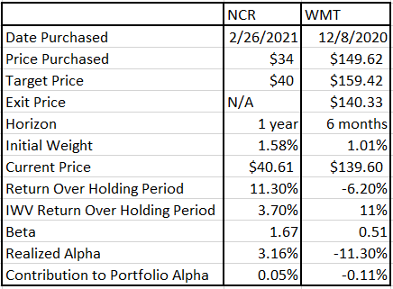
Performance

Slide 22
Walmart
Thesis:
Walmart is trading below its historical self due to uncertainty surrounding market conditions. We believe their big bet on e-commerce will payoff. The following three evidences makes us believe it is true:
Due to the COVID-19 pandemic, we will see additional government interventions (shutdowns, stimulus, etc.) before a vaccine is distributed
Walmart is uniquely positioned to benefit from the interventions in (1)
Walmart+ will lead to increased market share and earnings as behaviors change

Slide 23
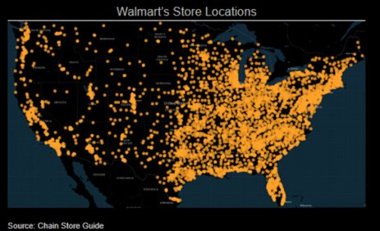
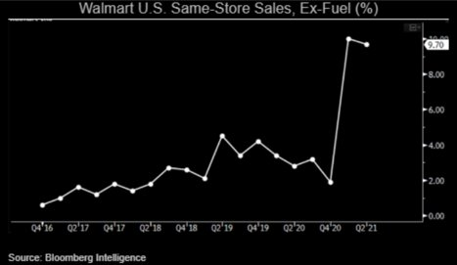
Unique position
Store Base​
With over 4,700 stores locations across the US WMT is uniquely positioned to supply an increasing demand​
Grocery Delivery and Pick-up​
Private-label Brand​
Private-label products have seen an increase in demand during the pandemic​
WMT is consistently improving the quality of its fresh meat and produce, driving more traffic into the stores.​
WMT has been improving the range and quality of the its private-label products​
Walmart’s Core business is Strong

Slide 24
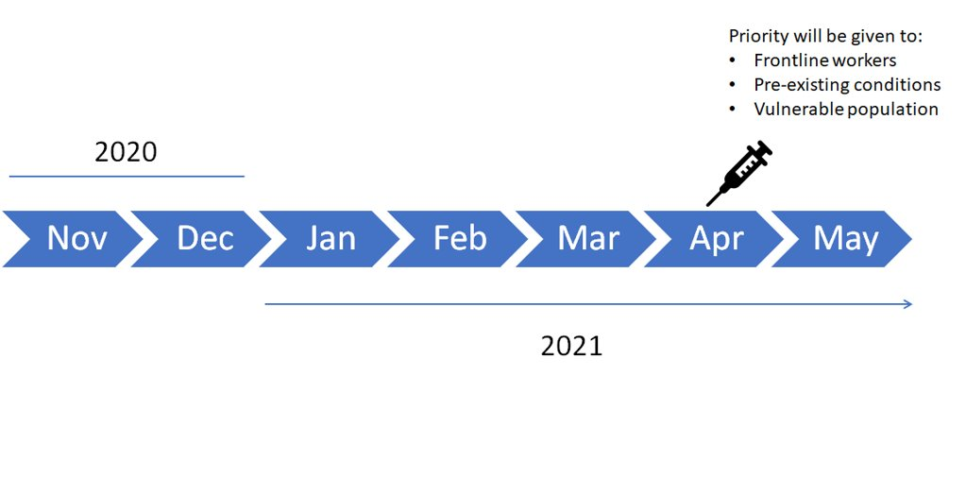
Covid and Vaccine Schedule
With the ongoing surge of Covid-19 cases in the US and throughout the World and with the time taken for a vaccine to be widely available, the population will still face lockdowns and public health measures to prevent and slow down the spread of the virus.

Slide 25
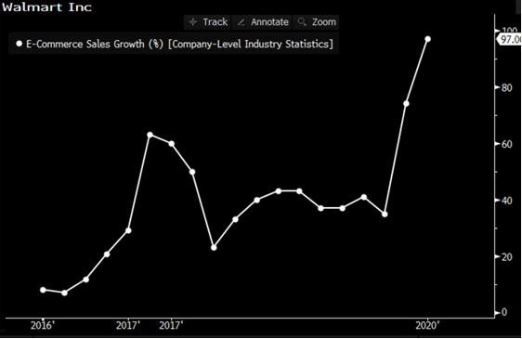
Walmart +
In September, Walmart launched its “Walmart +” subscription service that offers same-day delivery of groceries and smaller general merchandise items.
Due to the high-caution attitude of customers during the COVID-19 pandemic, we expect to see Plus membership grow at very high rates over the next six months.
Walmart e-commerce sales grew exponentially in 2020 amid the coronavirus pandemic as people were dining out less and staying home more, Walmart has the opportunity to lock in loyalty of new customers that came during the pandemic, after the pandemic.
The change in shopping behavior even after the pandemic is under control might contribute to Walmart consistently growing its Walmart + subscription service and online sales.

Slide 26
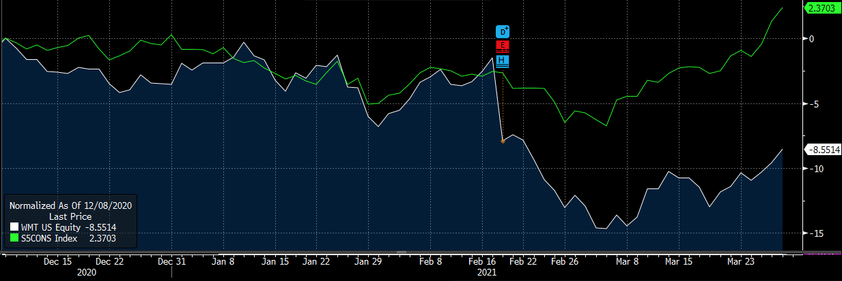
Walmart vs. Consumer Staples sector
Walmart’s decision to repay property tax relief in the U.K., linked to its ASDA division, clipped earnings by 7 cents per share
Walmart Inc. reported fourth-quarter earnings that fell short of expectation (Adj. EPS of $1.39 missed analysts’ estimate of $1.51)
COVID-related costs
Ongoing investments in e-commerce
Guidance for sales growth to be moderate

Slide 27
Lesson Learned & Outlook for future
Lesson learned
“In the short term the market is a voting machine, but in the long run the market is a weighing machine”
~ Benjamin Graham
It is impossible to predict those wildcard events
If you want returns different than the market you have to think different
You can be right for the wrong reasons
Outlook for future:
We have already closed out this position on Apr. 6

Slide 28
Communications & Industrials Review
2020/2021

Slide 29
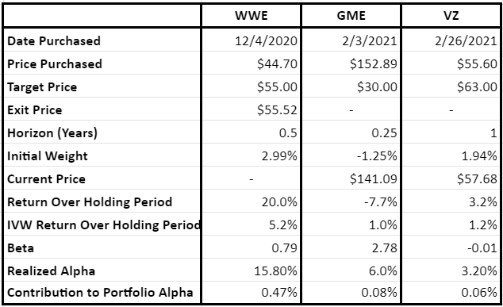
Performance
Notes:
Brett

Slide 30
Verizon (VZ)
Thesis:
Based on our research, we believe that the market is overemphasizing the threat from the new T-Mobile, which recently merged with Sprint and has taken an early lead in the 5G race.
While T-Mobile currently boasts the most extensive 5G coverage due to its large mid-band spectrum holdings, Verizon is well-positioned to provide superior 5G service by the end of 2021 due to its larger high-band spectrum holdings and mid-band spectrum licenses recently acquired in the latest FCC auction.
Notes:
Brett

Slide 31
What is 5G and Why Does it Matter?
Notes:
Brad

Slide 32
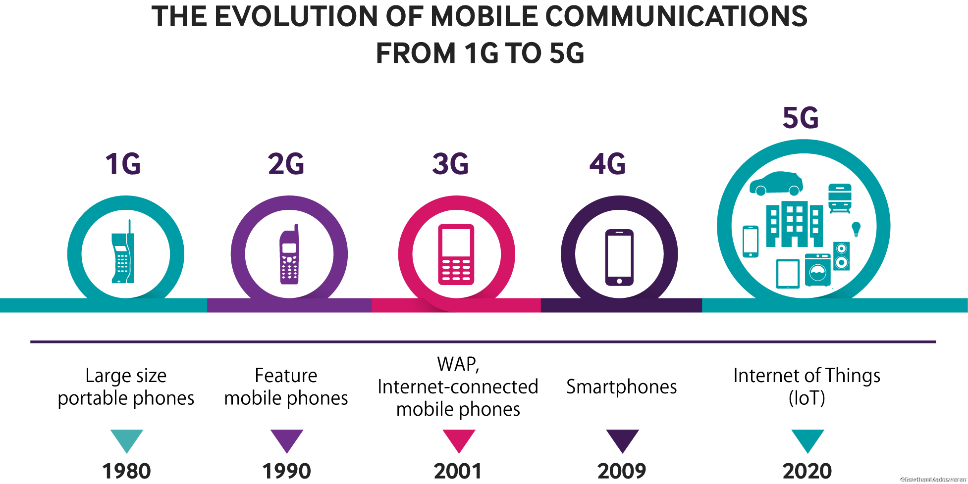
The Evolution of Mobile Communications from 1G to 5G
Notes:
Brad

Slide 33
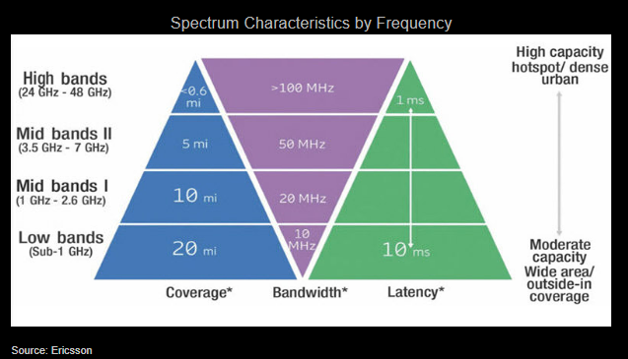
Not All 5G Created Equal
Notes:
Brad

Slide 34
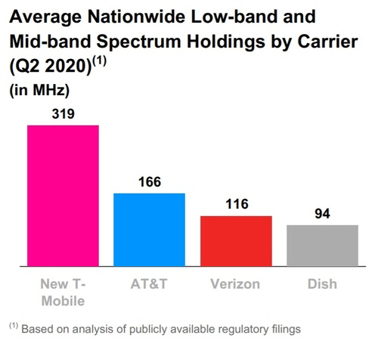
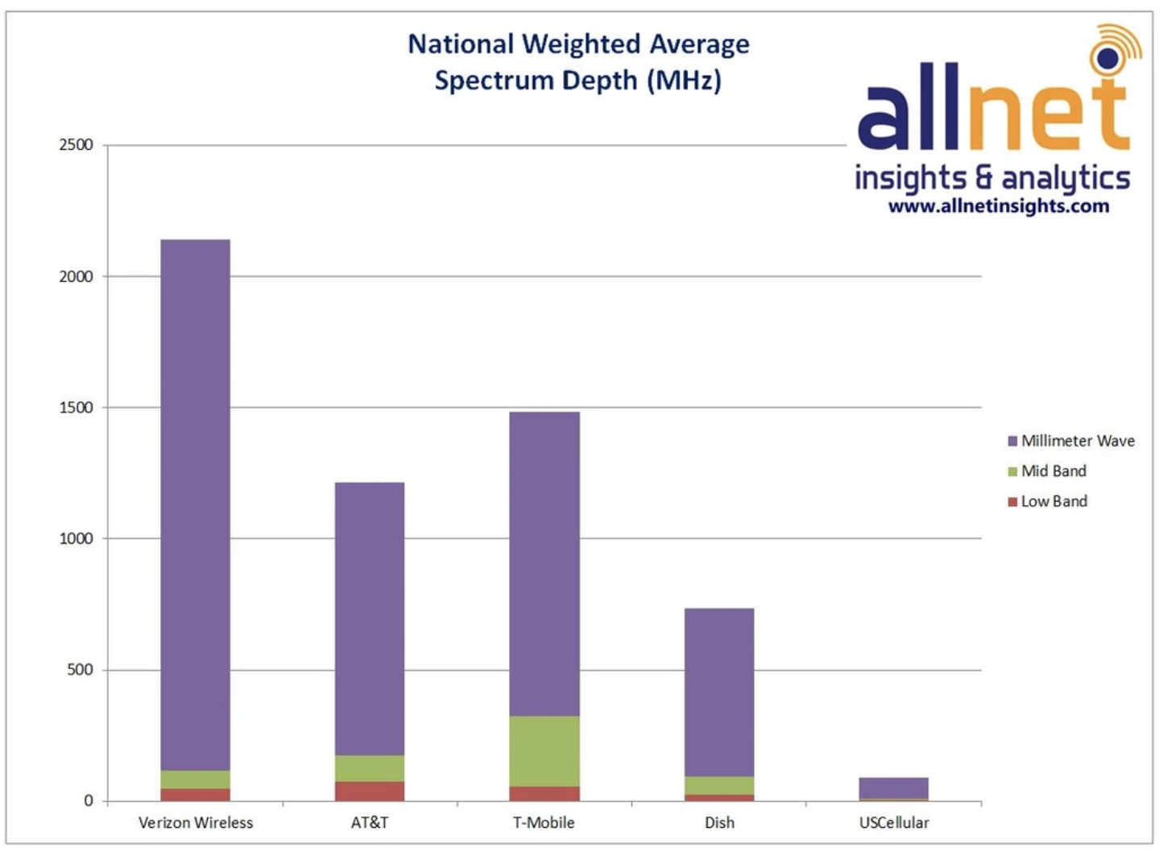
Current 5G Race
T-Mobile Has Lead with Key 5G Spectrums while Verizon Leads in MM Wave Spectrum
Notes:
Michael

Slide 35
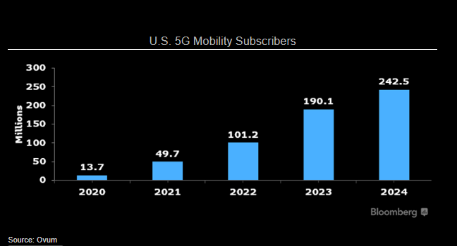
Why is 5G Important?
5G Mobile Subscribers Expected to Have CAGR of Over 75% During the Next 4 Years
Notes:
Michael

Slide 36
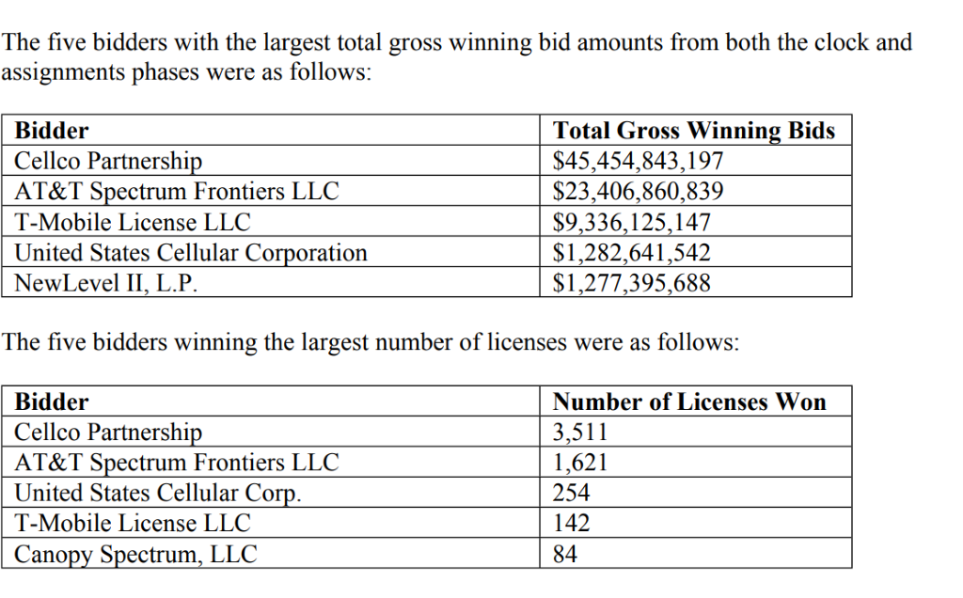
Verizon Taking Significant Steps to Catch T-Mobile
Notes:
Michael

Slide 37
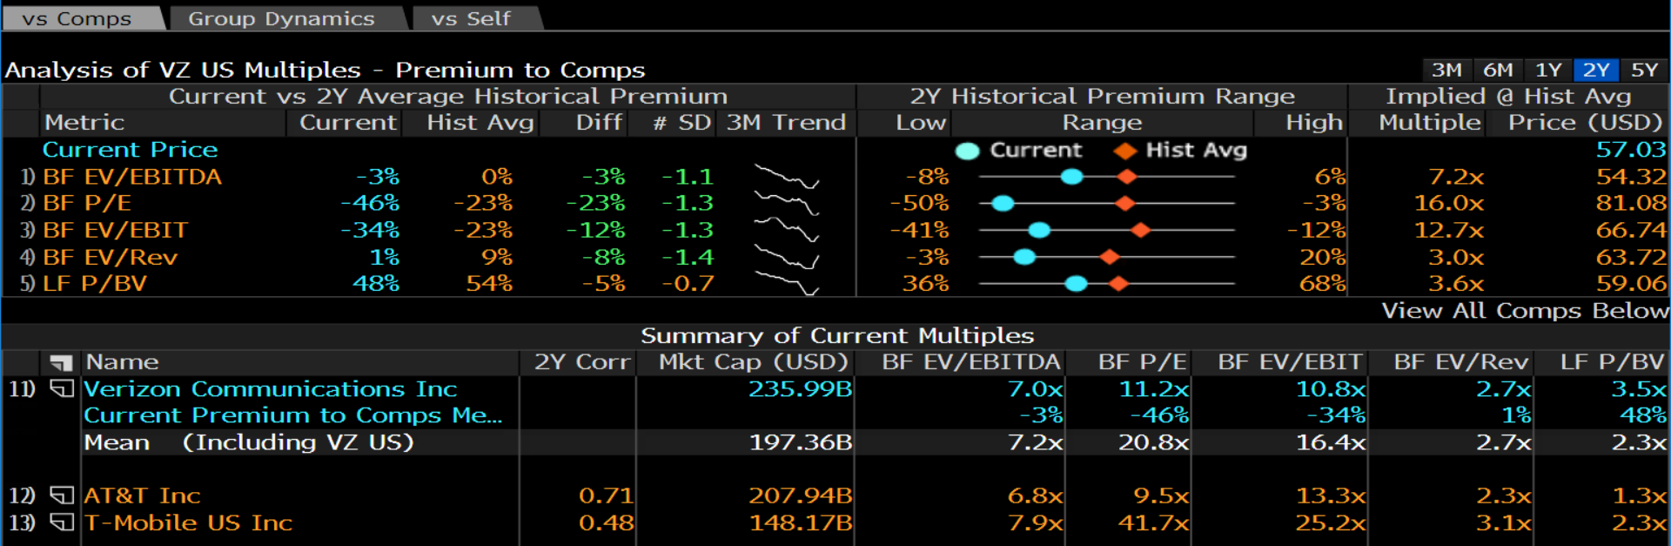
Valuation
Notes:
Brett

Slide 38
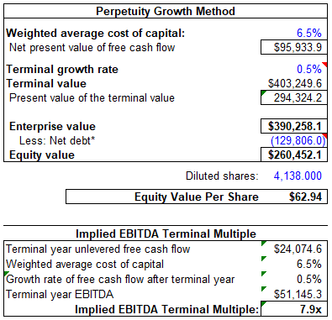
Valuation
Notes:
Brett

Slide 39
Verizon (VZ)
Outlook for Future:
Verizon will continue to provide superior-quality wireless service in the future, which will protect its dominant market share and justify its superior margins moving forward.
Notes:
Brett

Slide 40
Team 5 - Energy & Materials
Isaac Artinger, Joseph Lunt, Kimberly Tarnasky
Notes:
isaac

Slide 41
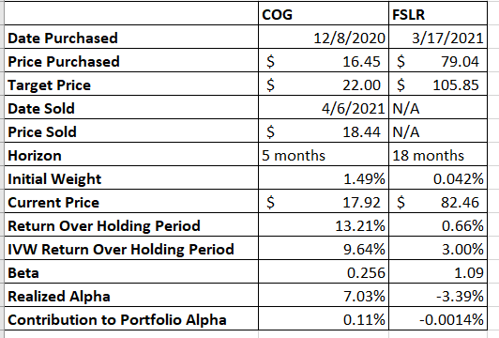
Performance Overview - Cabot Oil / First Solar
Notes:
Isaac
Founded 1999 and headquartered in Tempe Arizona
It produces a solar panel called the series 6.
Customers: Renewable Energy Companies
Suppliers: Multiple different material, technology, and renewable energy companies.
50% revenue comes from production and selling of solar panels and (50% revenue) comes from project development, repair management

Slide 42
Thesis Review
First Solar is undervalued due to government support, superior technology, and market overreaction to recent news.
First Solar will benefit from increasing government support from blue sweep that their international competitors will not be receiving.
First Solar has superior technology that they are able to make more efficiently
The market’s outlook for First Solar is less optimistic than for their competitors because of missed earning and delay in sale of large project.
Notes:
Joseph

Slide 43
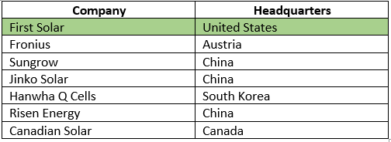
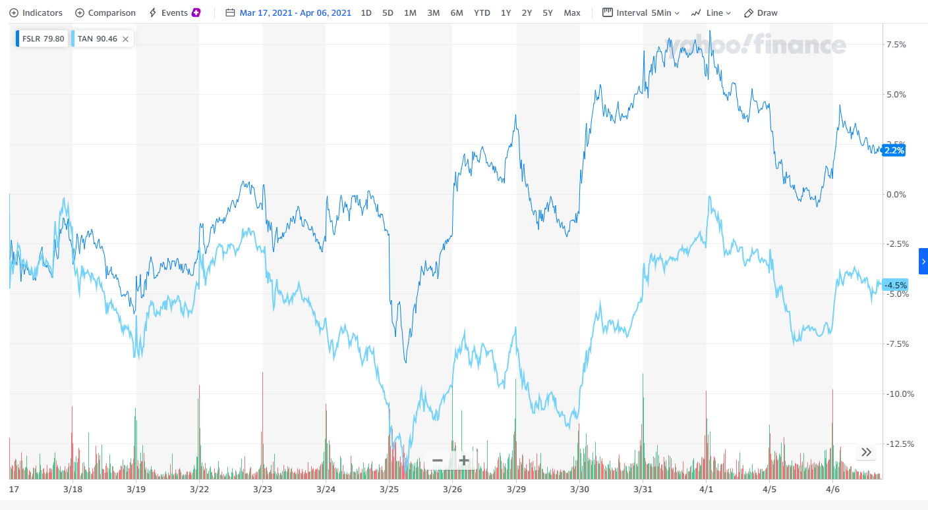
Thesis Point #1
The Biden administration has promised to support clean energy companies in the US. Most First Solar competitors are located outside the US, so they won’t benefit from any new policies
On 03/31/21, Biden announced a $2 trillion infrastructure plan that will greatly benefit clean energy. This strengthens our first thesis point.
Notes:
Kimberly
On Wednesday, Biden announced a $2 trillion infrastructure and clean energy plan
“The plan will retrofit millions of homes to increase energy efficiency” - CNBC
Biden will also propose an “Energy Efficiency and Clean Electricity Standard.” This would be a mandate requiring that a percentage of all US utilities come from clean energy. 30 US states already do this.
$180 billion to research and development
Strengthens first thesis point

Slide 44
Thesis Point #2
First Solar has superior technology that they are able to make more efficiently
The use of cadmium telluride instead of silicon allowed it to achieve a significantly lower module cost ($0.67 per watt), compared to crystalline-silicon PV, which averages $1.85 per watt.
The module 6 produces 430-460 watts and is 18.3% efficient versus most that produce 250 watts and are 11-15% efficient.
Why it may not hold true: Competitors are quickly going to catch up.
Notes:
Isaac
We believe that First Solar’s model of efficiency is different enough from their competitors that it will take at least 2-3 years for their competitors to catch them at their current level. We also think that the market is failing to take into account First Solar’s ability to innovate and come up with better products.
To conclude we believe First Solar has shown the ability to innovate in the past and will continue to do so in the future.

Slide 45
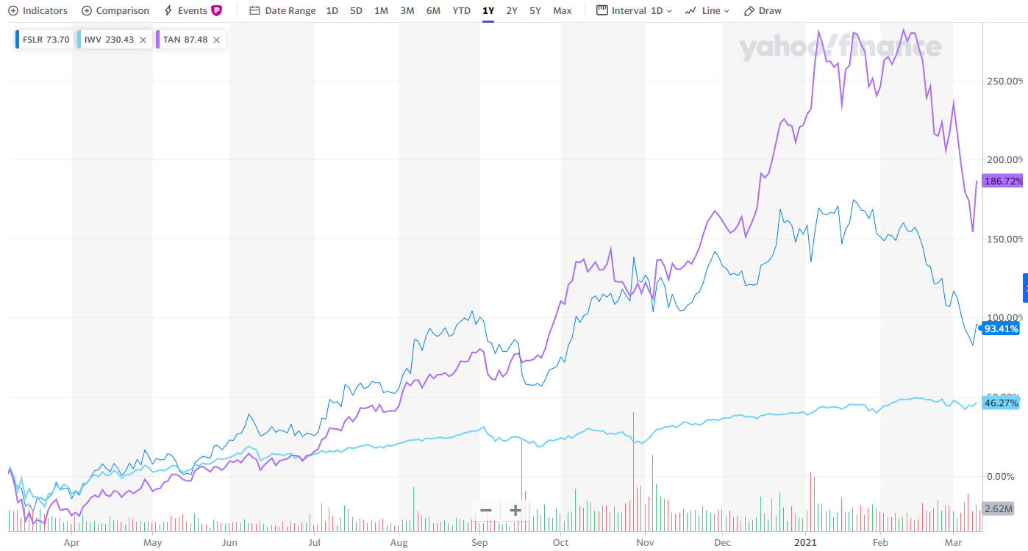
Thesis Point #3: The market outlook for First Solar is less optimistic than for their competitors.
The market’s outlook for First Solar is less optimistic for their competitors and we disagree
Solar Industry had suffered in February due to interest rate concerns.
First Solar has missed earnings, experienced delays about sale of a large project.
Concerns about Biden removing tariffs.
Concerns about competitors catching up in terms of solar panel efficiency.
Notes:
Joseph

Slide 46
Outlook for Future/Lesson Learned
Future Outlook
We believe the thesis points for First Solar still hold. Since Biden’s announcement of the infrastructure plan, we believe thesis point 1 is even stronger
Lessons Learned about this Sector
Interest rates have make a large impact on the renewable energy sector because they invest in many long term projects with debt.
Because companies in both of these sector produce very similar products, what sets them apart is the efficiency with with they create them.
Notes:
Kimberly

Slide 47
Consumer Discretionary & Healthcare
Corrine Richter, Eva Li, & Max Vaterlaus

Slide 48
Positions | Etsy | Pfizer | Stitch Fix
Date Purchased | Nov. 17, 2020 | Nov. 18, 2020 | Nov. 20, 2020
Price Purchased | $127.68 | $37.14 | $35.38
Target Price | $150.00 | $54.22 | $25.32
Horizon | 12/31/21 | 12/31/21 | 04/21/21
Initial Weight | 2% | 3.0% | -1.1%
Current Price | $215.69 | $35.96 | $49.51
Return Over Holding Period | 58.37% | -3% | -40.02%
IVW Return over Holding Period | 14.97% | 14.97% | 12.88%
Beta | 2.165 | 0.17 | .47
Realized Alpha | 23.75% | -0.017 | -37.04%
Contribution to Portfolio Alpha | 0.47% | -0.05% | -0.4%

Slide 49
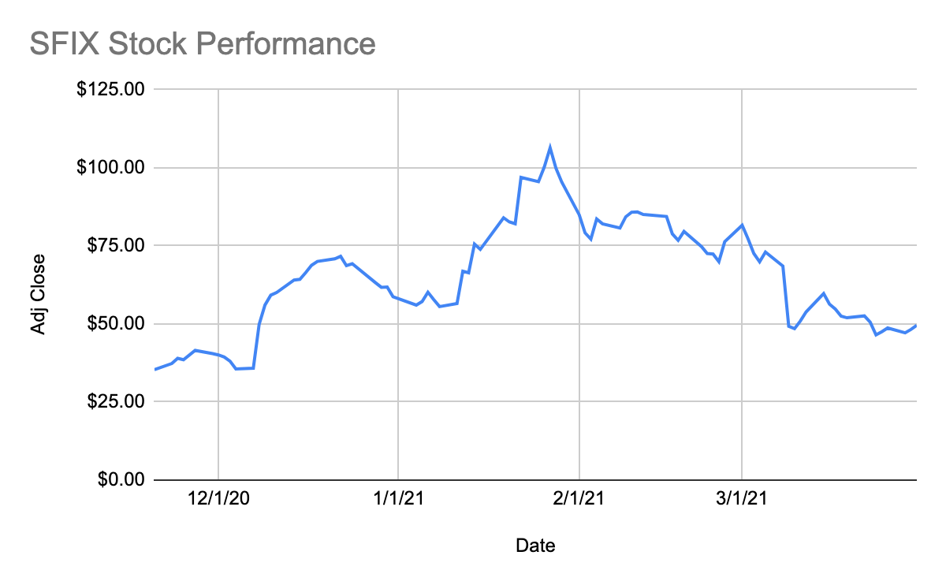
Stitch Fix
Alpha (realized): -37.04%
Alpha (annualized): -82.65%

Slide 50
Investment Theses
Recommendation: Short
Target Price: $25.32
Forecasted Return: 30.18%
Discouraging Financials
Decelerating growth, margin compression, declining returns on capital (ROE, ROIC, ROA, EBIT/NCTA), declining sales efficiency, never profitable, yet valuation multiples remain high.
Bleak Outlook Post-COVID
We believe customers will start switching to brick-and-mortar stores post-COVID which will lower retention rates for Stitch Fix. Current retention rates are probably bad since the management team is never willing to disclose it.
Highly Competitive Market
The clothing industry is highly competitive and big players like Amazon are entering in the subscription clothing market, which may result in price wars and further slowdown in growth.

Slide 51
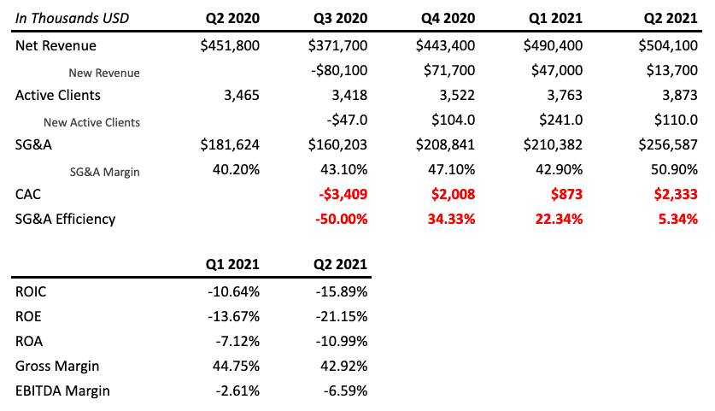
What unfolded from our thesis?
Limitations in business model
Can’t benefit from holiday sales due to consumer behavior shift to gift giving
Worsened unit economics & financials
Lower net revenue/active client, CAC, SG&A efficiency, and never disclosed retention rate
Lower ROIC, ROA, ROE, and margins
EV/Rev multiple remains high
Current: 3.01x, our upside: 2.1x, 2020 avg EV/Rev = 1.33x, 3-year avg: 1.84x
Profitability is unsustainable
Profit surprise due to CARES Act (expires Jan 1, 2021), Biden plans to raise corporate taxes
Notes:
Stitch Fix defines active clients as people who have bought an item directly from its website, called a "fix," in the preceding 52 weeks from the last day of the quarter
Under the CARES Act, an NOL from a tax year beginning in 2018, 2019 or 2020 can be carried back five years. Taxpayers don't have to carryback their 2018, 2019 and 2020 NOLs. ... As it stands right now, this five-year carryback provision goes away for tax years beginning in 2021

Slide 52
What no longer aligns with our thesis?
Improvements in Business Model
Fix Preview, Shop By Category, Live Styling: Increases TAM & conversion rate. Keep rate & AOV went up by 10%, may improve financials in the long run.
Temporary Missed Earnings
Holiday e-commerce sales lead to carrier delays. On the flip side: carrier concentration problems
Mixed Post-COVID Impacts
Supply chains will go back to normal, disposable income may increase
Management Team Improvements
New CFO (15 years at Amazon as CFO/VP in digital, advertising & corporate development finance) & CPO are from Amazon (14 years at Amazon as VP, run Community Shopping)
Conservative Valuation Multiples
EV/Rev may be inaccurate as company’s revenue recognition is different, M&A and private company comps show high EV/Rev multiples
Le Tote: Personalized clothing subscription & rented fashion for women, Nov 2019, 2.79x EV/Rev, 130% Rev Growth
Trunk Club: Personalized mid- to high-end men's and women's subscription box, July 2014: 3.43 EV/Rev, 376% Rev Growth
Rent the Runway: Premier subscription fashion service to rent designer styles, Dec 2016: 6.2 EV/Rev, 67% 3-year CAGR

Slide 53
Overall Successes and Learning Opportunities
Successes
Identified metrics that matter/Industry-specific metrics
Some thesis points did play out (Stock has fallen more than 54% since January)
Limitations in business model
Bad financials & unit economics
High revenue multiples
Unsustainable profitability
Learning Opportunities
Even if some of our thesis does play out, other factors can continue to push the price away from our target.
How can we hedge against this?
Craft a trade to isolate the factors we are interested in.
Frequently revisit positions. Ask, would I still buy/short this stock today?
Have strong & specific catalysts
Ask, why now? Timing is important.
Consider what strategies the company may implement/be implementing that could weaken our thesis
Notes:
Think about what strategies and growth the company is attempting to implement and incorporate that into the analysis.
Ask, why now? - Timing
Find ways to craft a trade that would hedge against upside catalysts (potentially long a subscription retail company)

Slide 54
More Lessons Learned
Metrics to evaluate a subscription business
LTV: AOV * Gross Margin * Customer Lifespan
Customer Lifespan = 1/churn rate
CAC: # of New Customers / S&M expense during that period
Other Sales Efficiency Metrics
SG&A Efficiency: Incremental Revenue / SG&A expense during that period
Magic Number: (Recurring revenue in current quarter - Recurring revenue in previous quarter) / previous quarter S&M expense
Conversion rate: very important if they have trials & freemiums, in Stitch Fix’s case this is keep rate
Choosing correct multiples
Note accounting differences for comps. (Eg. for Stitch Fix there’s differences in revenue recognition)
Comps are in later life cycles compared to target company, use forward multiples of target company. (Eg. Stitch Fix is still a growth stock)
Multiples | When to use | When not to use
EV/Rev | Big differences in accounting policies Unprofitable or cyclical firms | Variable, periodic sales, like property developers
EV/EBITDA | Differences in depreciation & capital structure Similar capital intensity | Different capital intensities => EV/EBIT is better

Slide 55
Appendix

Slide 56
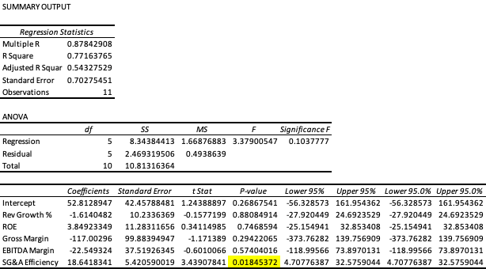
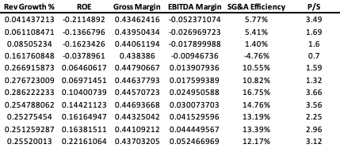
Regression Analysis for Stitch Fix

Slide 57
Quant Strategy
Brandon Ly
Ellie Evans
Mark Rose
Notes:
We're also trying to strategize to systematically generate alpha by capturing market inconsistencies.

Slide 58
Researched Strategies
Momentum
Low Beta
Low Residual Volatility
Meta-momentum
Benchmark Timing
Notes:
complications with the optimizer delayed the implementation of the other simpler strategies.
The benchmark timing strategy is leaning into the benchmark on certain days and leaning out on other days.
“Our idea is that risk associated with the benchmark is compensated only on days where macro news is released.” Our set of macro news events include FOMC announcements, GDP prints, CPI releases, and unemployment results. Remember that these people have never seen any of this before and will need some context.

Slide 59
Why macro announcement days matter
CAPM says market beta should be sole determinant of excess returns
Historically, low beta stocks outperform high beta stocks (in terms of alpha)
Frazzini & Pedersen (2014)
Is holding market risk (beta) ever rewarded with higher excess returns?
If we can predict when this relationship will hold, we can time a benchmark or low-beta strategy

Slide 60
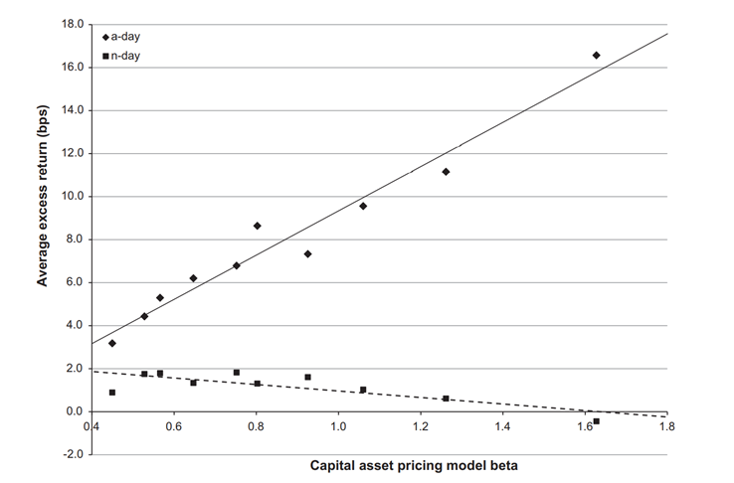
Asset Pricing: A Tale of Two Days
Savor & Wilson (2012)
Notes:
We’re not rewarded for holding market risk if not on an announcement
Holding more beta is usually not rewarding, unless on an a-day
Not an alpha strategy, holding risks when it pays off

Slide 61
Thesis
Thesis:
Holding market risk (beta) is only rewarded on a-days
At times when investors expect to learn important information about the economy, they demand higher returns to hold higher beta assets.
Implementation:
Buy ETF at prior-close and sell at close on a-days
This allows us to take on extra market risk (beta) when big announcement news is made
Risks:
ETF could react poorly on a-days due to surprise news

Slide 62
Lessons Learned
Brainstorming strategies:
Read the literature
Avoid data mining (have a clear thesis)
Familiarity with factors:
Helps explain the nature of returns
Translating ideas to quantifiable models:
Thesis → Tradable Strategy
Backtesting:
Out-of-sample & robustness checks
Notes:
Ellie
Examples:
Literature: Pavel & Savor, 2012
Clear Thesis: Market risk is rewarded on a-days b/c investors demand higher returns for holding high beta assets when expecting to learn important macroeconomic info.
Factors: market beta determines excess returns on a-days only.
Strategy: take on market risk by holding shares of ETF on a-days
OOS: (2011 - 2017) original is 1964 - 2011
Preciseness Test: buy 1 day early, sell 1 day late

Slide 63
Appendix

Slide 64
What About Large Swings…?
One potential alternative explanation for our results is that there is nothing special about announcement days per se, but rather that the strong positive relation between betas and returns documented on such days is actually driven by some particular feature of announcement days that is also shared by other days. However, we do not find evidence supporting this alternative hypothesis. We show that no similar relation exists on days when the stock market experiences large moves, or on those days when average market returns are predictably higher than the sample mean (more speciÖcally, during the month of January or during the turn of the month).

Slide 65
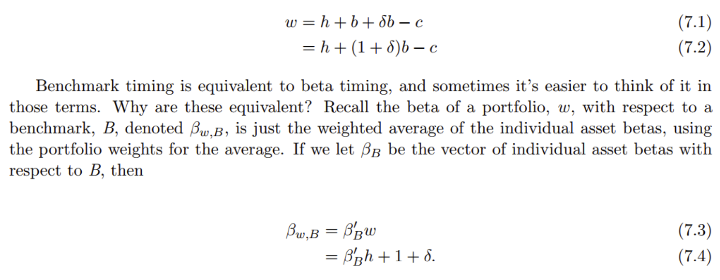
Implementing strategy by increasing exposure to market on a-days

Slide 66
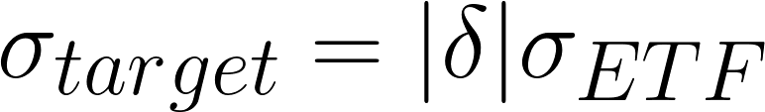
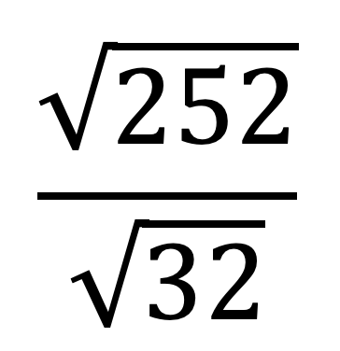
Limiting Strategy Risk
Fund approved: 0.0025 (0.25%) risk allocation
Solve for !
(Note: need to multiply LHS by to spread risk over each of the 32 a-days in 2021

Slide 67
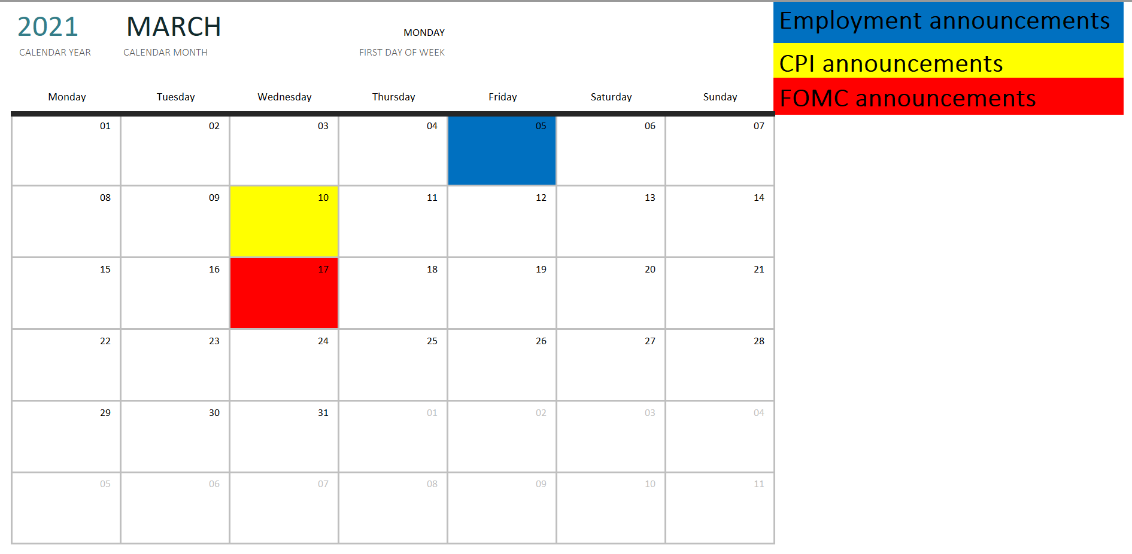

Slide 68
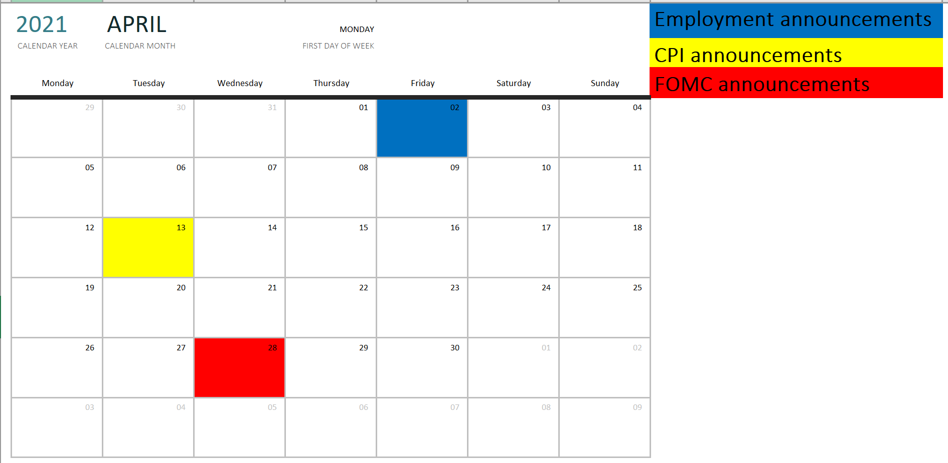

Slide 69
Worst a-days to buy high-beta stocks (2010-2019)
Date | Type | Excess returns | Reason
10/10/2018 | PPI | - 4.7% | Rising interest rates
9/21/2011 | FOMC | - 4.6% | Operation twist
2/4/2010 | Emp | - 4.4% | Poor job report
2/5/2016 | Emp | - 4.0% | Stock market volatility
10/29/2014 | FOMC | - 3.6% | Rising interest rates
12/7/2018 | Emp | - 3.6% | Stock market volatility
1/15/2015 | PPI | - 3.5% | Oil price collapse
3/15/2016 | PPI | - 3.4% | Rising interest rate expectations

Slide 70
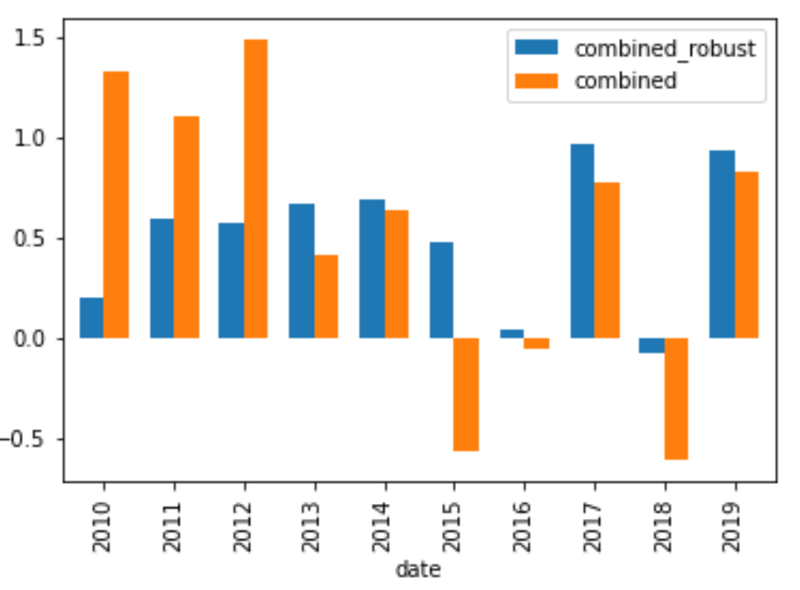
Average Annualized Sharpe Ratio By Year - Robust check
AVERAGE SHARPE RATIO (2010-2019)
Combined strategy: 0.53
Combined_robust strategy: 0.50

Slide 71
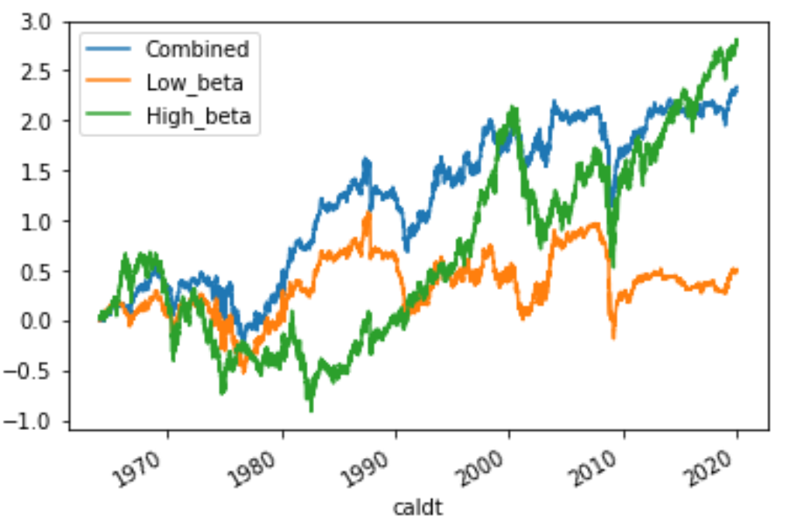
Cumulative Excess Returns
“Beta” of High Portfolio: 1.55
“Beta” of Low Portfolio: 0.15
“Beta” of Combined Portfolio: 0.29

Slide 72
Notes
https://papers.ssrn.com/sol3/papers.cfm?abstract_id=2024422

